Slide 1
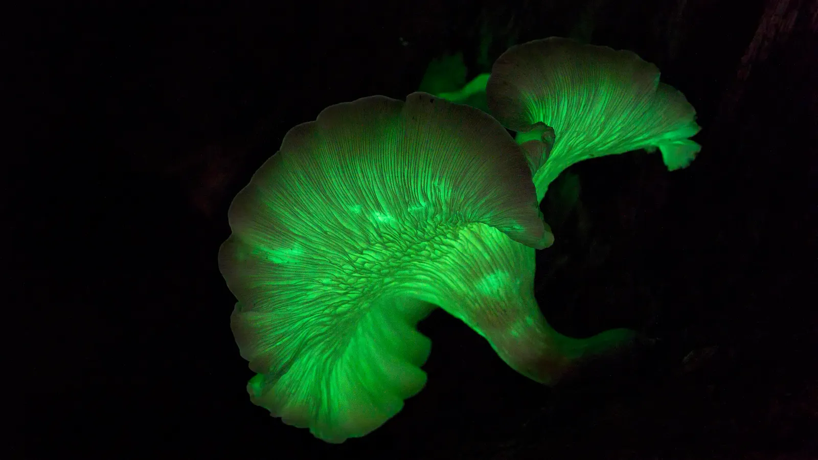


WELCOME TO MY PRESENTATION MD. SAZZADUR RAHMAN Student ID: BMB22019 Session: 2021-22 2nd Year, 1st Semester Department of Biochemistry and Molecular biology Mawlana Bhasani Science and Technology University Santosh, Tangail.

Slide 2
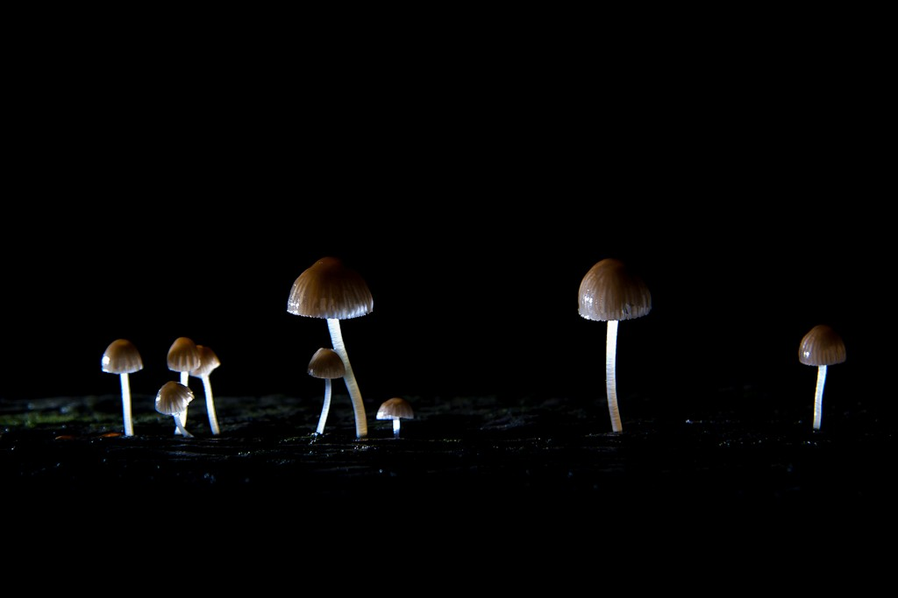
Fungi
Fungi are eukaryotic organisms that include microorganisms such as yeasts, moulds and mushrooms

Slide 3
Classification
Classification Of Fungi
Nutrition
Spore
Saprophytic
Parasite
Symbiotic
Zygomycetes
Ascomycetes
Basidiomycetes
Deuteromycetes

Slide 4
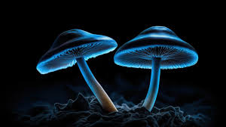
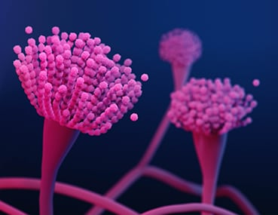
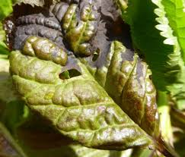
Parasite: An organism that lives in or on an organism of another species
(its host) and benefits by deriving nutrients at the other's expense.
Ex: Taphrina
Saprophytic: Obtaining food by absorbing dissolved organic material;
Ex: Aspergillus, Penicillium
Symbiotic: Involving interaction between two different organisms living in close physical association.
Ex : Lichen
Aspergillus
Taphrina

Slide 5
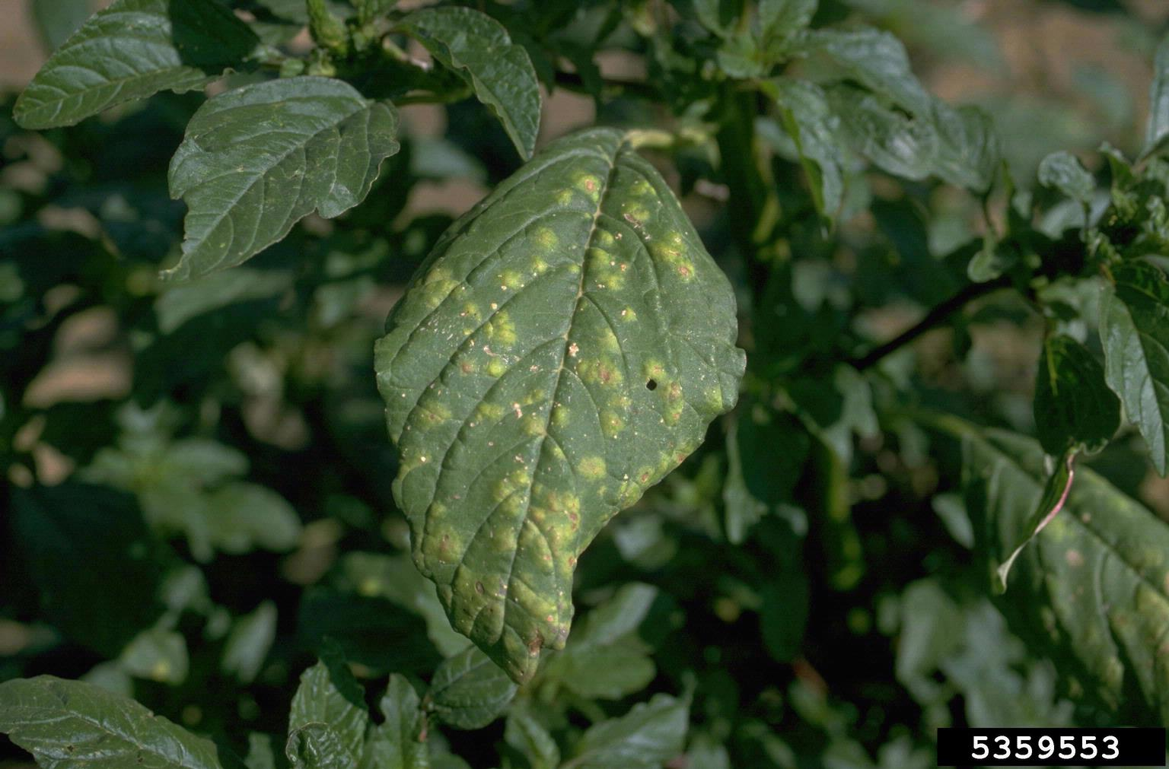
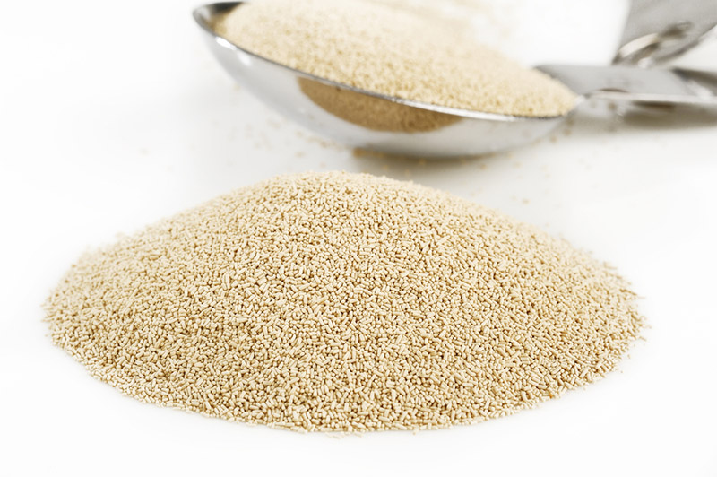
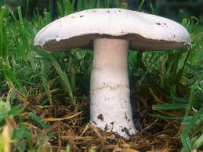
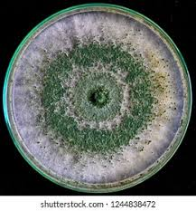
Phycomycetes: Albugo
Ascomycetes : Yeast
Basidiomycetes: Agaricas
Deuteromycetes: Trichoderma

Slide 6
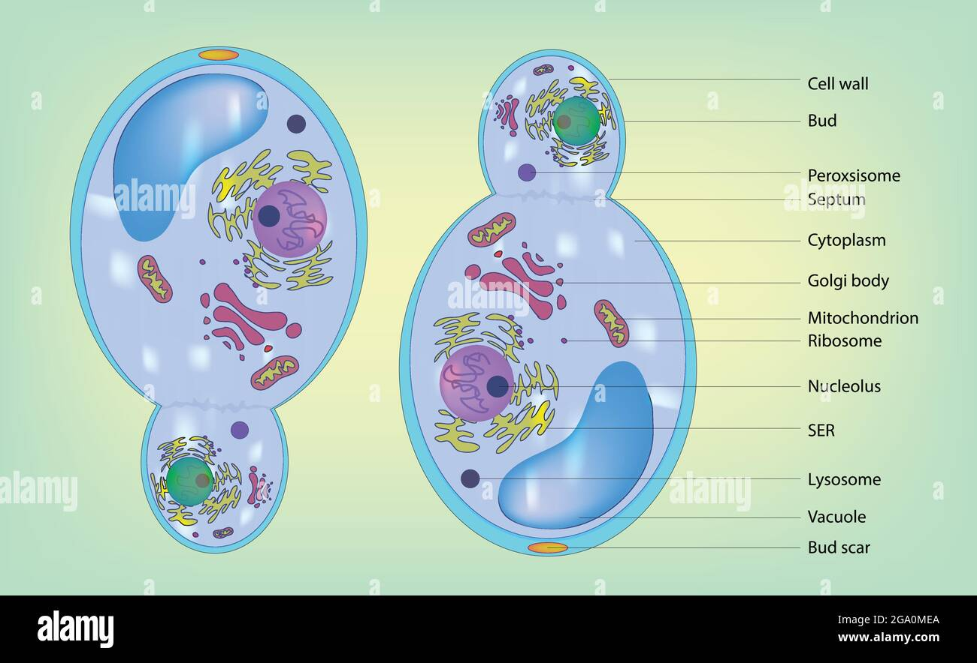
Cell structure of fungi

Slide 7
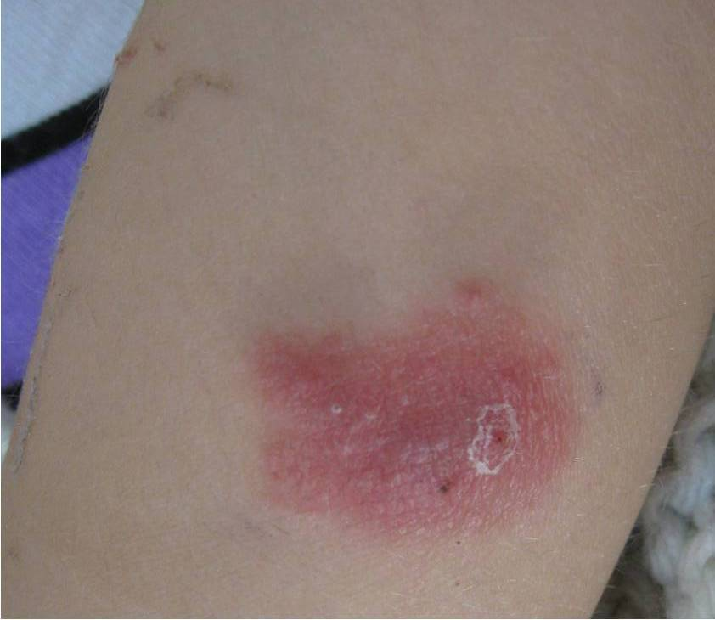
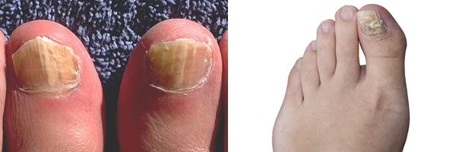
Types 0f fungal disease
1. Aspergillosis: Allergy reaction and Chronic lung
condition occurs.
2. Onychomycosis: Fungal nail infections, also known as “onychomycosis,” are very common. They may affect up to 14% of the general population. Fungal toenail infections are more common than fungal fingernail infections.

Slide 8
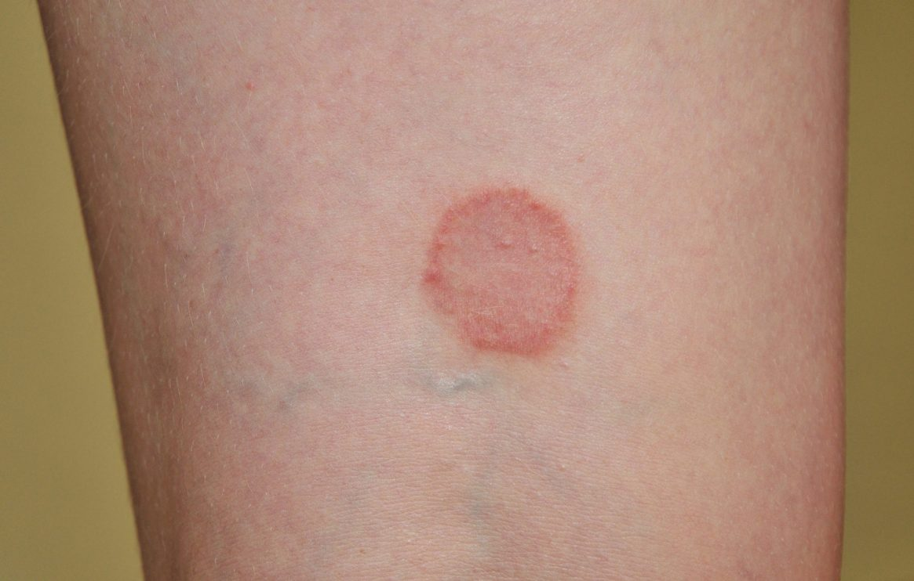
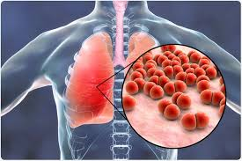
2. Ringworm: Ringworm is a common skin infection that is caused
by a fungus. It's called “ringworm” because it can cause a
circular rash (shaped like a ring) that is usually red and itchy.
Anyone can get ringworm.
3.Pneumonia : Pneumonia is an infection that affects one or both
lungs. It causes the air sacs, or alveoli, of the lungs to fill up with
fluid or pus. Bacteria, viruses, or fungi may cause pneumonia

Slide 9
Economical importance
1. Agriculture:
Pest
Agri engineering
One gene one enzyme hypothesis
Symbiosis
2. Food:
Mushroom
Fermentation
Baking
3. Medicine:
Antibiotics
Post child birth bleed
Prevent cancer

Slide 10


